Slide 1
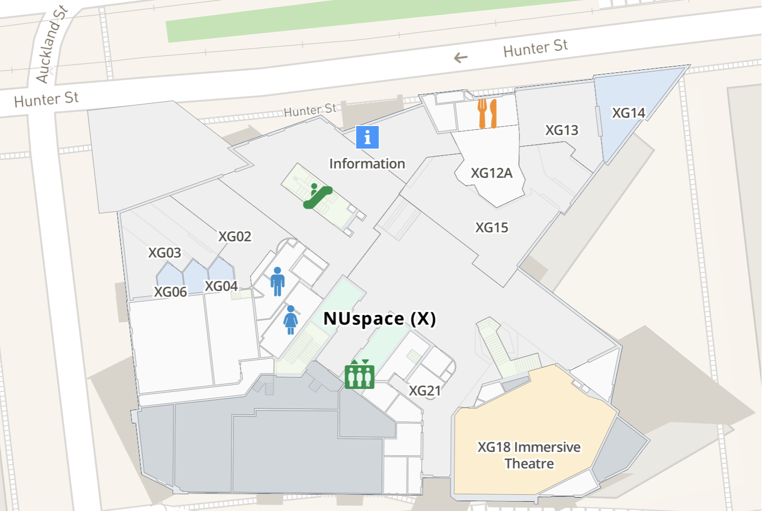
Ground Floor
Facilities
Unisex/disabled toilet
Parent Room
First Aid/Security
Sensory considerations
Registration area.
Bright fluorescent lights.
Likely to be crowded.
Potentially noisy areas.
Generally warm but temperature variable near entrances.
Gets a bit stuffy/smells dusty.
(1)
(2)
(3)

Slide 2
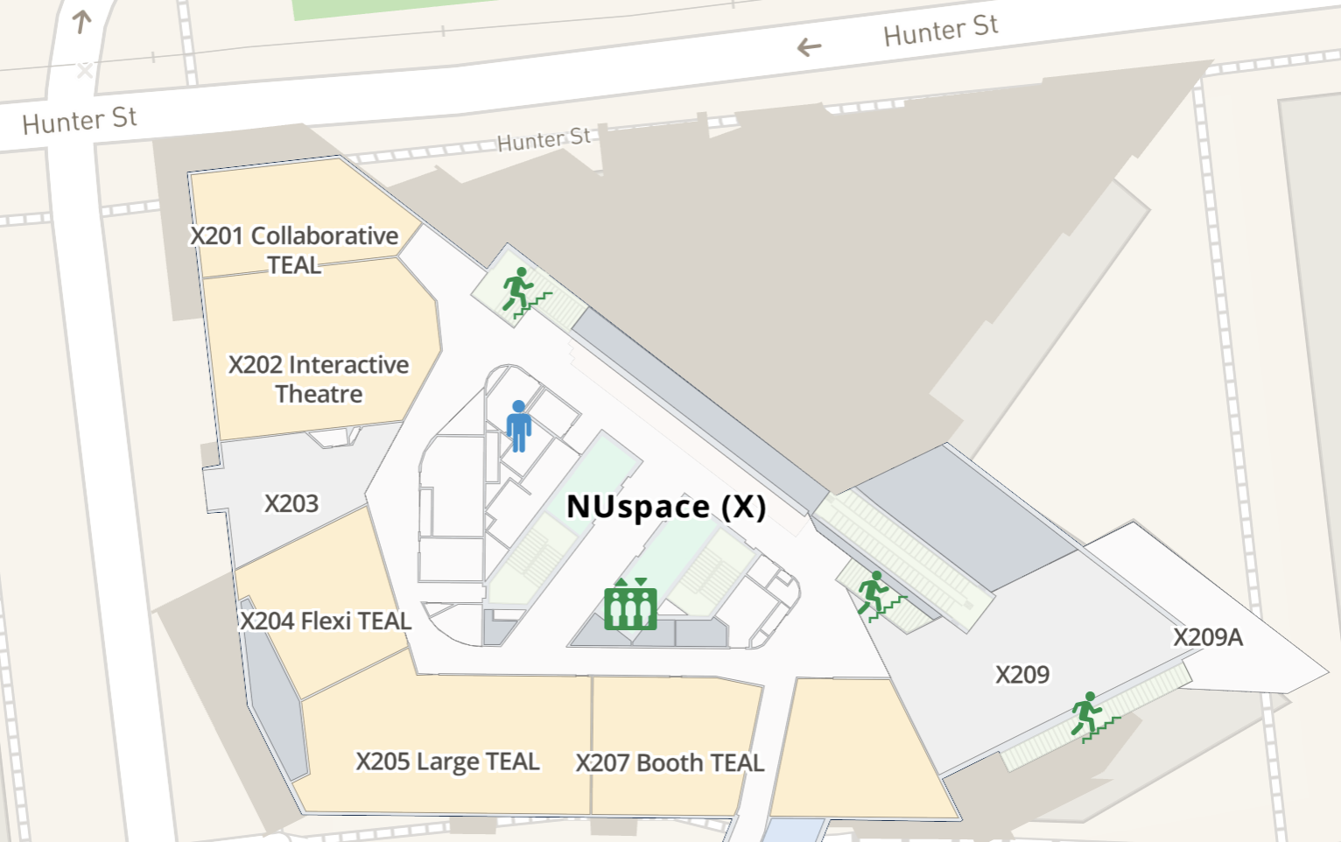
Second Floor
Facilities
Unisex/disabled toilet
Water station
Sensory considerations
Bright fluorescent lights.
Likely to be crowded.
Potentially noisy areas.
Corridors become narrow in some sections.
Some windows and natural light.
(1)
(2)

Slide 3
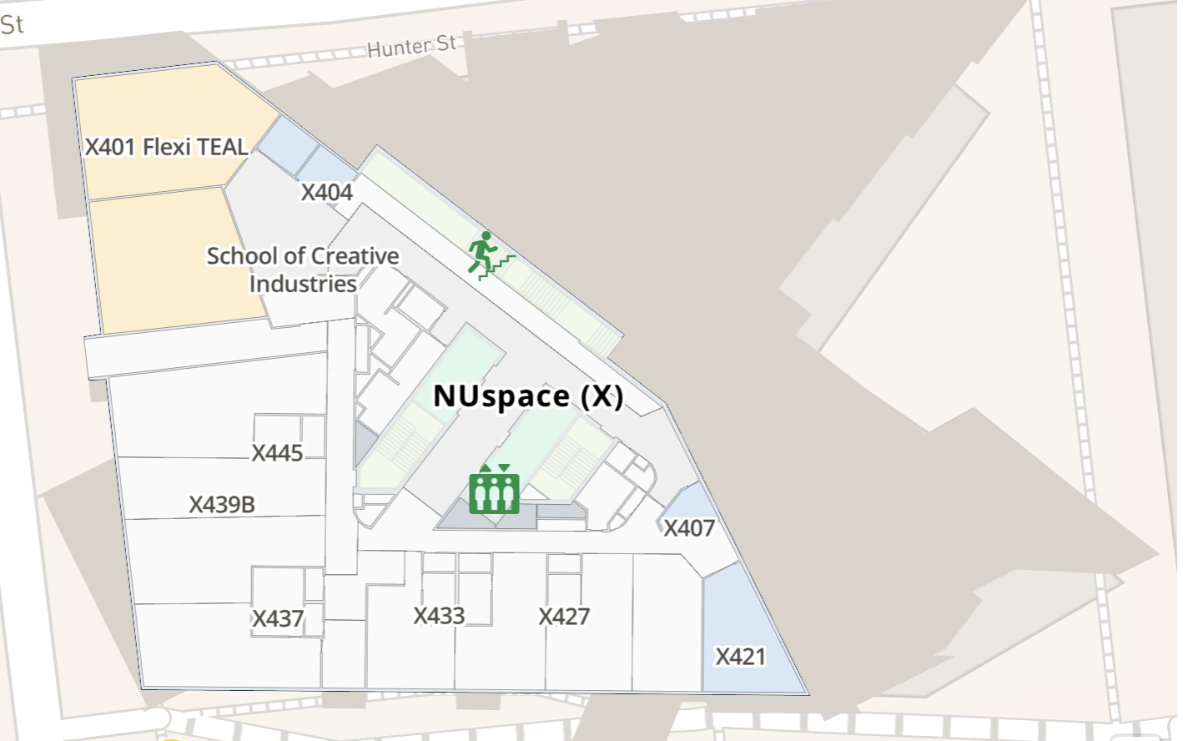
Fourth Floor
Facilities
Unisex/disabled toilet
Water station
Sensory considerations
Smaller common areas.
Bright fluorescent lights.
Potentially noisy areas.
Corridors become narrow in some sections.
Some windows and natural light.
(1)
(2)

Slide 4
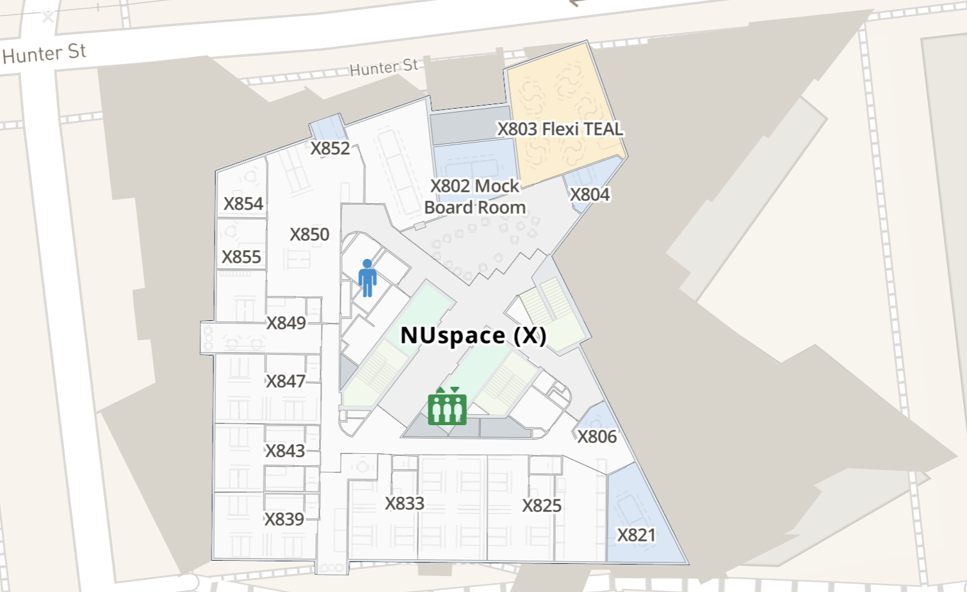
Eighth Floor
Facilities
Unisex/disabled toilet
Water station
Sensory room
(3)
Sensory considerations
Smaller common areas.
Bright fluorescent lights.
Potentially noisy areas.
Corridors become narrow in some sections.
Some windows and natural light.
(1)
(2)

Slide 5
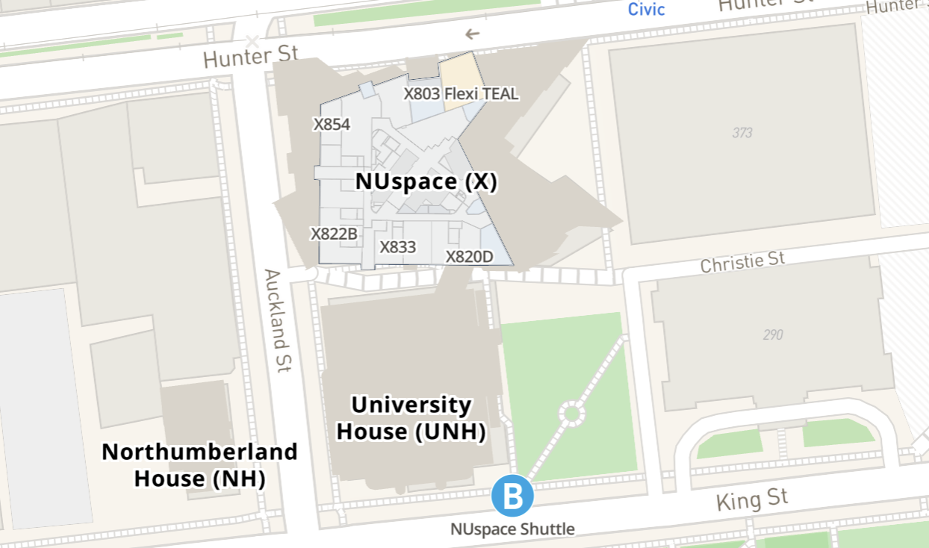
WattSpace Gallery
Facilities
Access ramp
Unisex/disabled toilet
Weaving space
Sensory considerations
Dim lighting.
Some audio-visual art and soundscapes.
Not heated.
Space produces echoes.
Some creaky floorboards.
Generally quiet space.
WattSpace

Slide 6
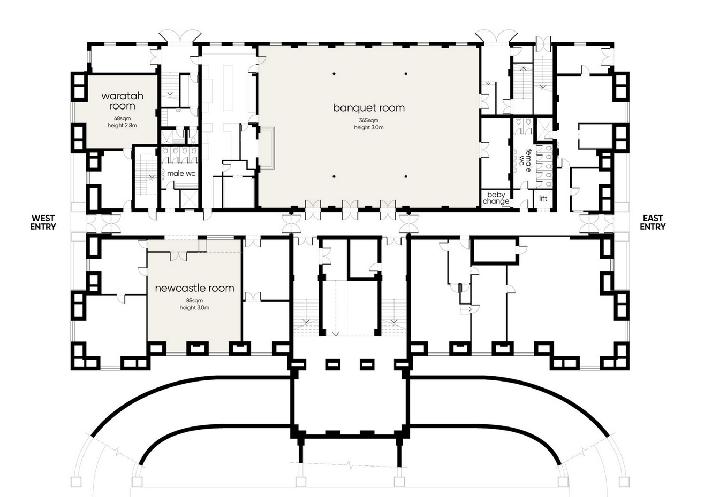
Town Hall
Facilities
Accessible entry to from the side entrances at Christie Street or Wheeler Place. Elevator located at the Wheeler Place end of the building.
There is a unisex accessible toilet facility (right hand transfer) located on Level 1 of Newcastle City Hall.
Sensory considerations
Strong food smells.
Crowded & noisy in food area.

